Slide 1

Azure Synapse Analytics Apache Spark

Slide 2

Azure Synapse Apache Spark - Summary
Azure Synapse Analytics > Apache Spark > Summary
Apache Spark 2.4 derivation
Linux Foundation Delta Lake 0.6 support
.Net Core 3.0 support
Python 3.6 + Anacondas support
Tightly coupled to other Azure Synapse services
Integrated security and sign on
Integrated Metadata
Integrated and simplified provisioning
Integrated UX including nteract based notebooks
Fast load of Synapse SQL (provisioned) pools
Core scenarios
Data Prep/Data Engineering/ETL
Machine Learning via Spark ML and Azure ML integration
Extensible through library management
Efficient resource utilization
Fast Start
Auto scale (up and down)
Auto pause
Min cluster size of 3 nodes
Multi Language Support
.Net (C#), PySpark, Scala, Spark SQL, Java

Slide 3
Apache Spark
Azure Synapse Analytics > Apache Spark
An unified, open source, parallel, data processing framework for Big Data Analytics
Spark Unifies:
Batch Processing
Interactive SQL
Real-time processing
Machine Learning
Deep Learning
Graph Processing
Spark SQL
Batch processing
Spark MLlib
Machine Learning
Spark Streaming
Stream processing
GraphX
Graph Computation
Spark Core Engine
Yarn
Spark MLlib
Machine Learning
Spark Structured Streaming
Stream processing
http://spark.apache.org

Slide 4



Motivation for Apache Spark
Azure Synapse Analytics > Apache Spark
Traditional Approach: MapReduce jobs for complex jobs, interactive query, and online event-hub processing involves lots of (slow) disk I/O
HDFS Read
Iteration 1
HDFS Write
HDFS Read
Iteration 2
HDFS Write
CPU
Memory
CPU
Memory

Slide 5
Motivation for Apache Spark
Azure Synapse Analytics > Apache Spark
Traditional Approach: MapReduce jobs for complex jobs, interactive query, and online event-hub processing involves lots of (slow) disk I/O
Solution: Keep data in-memory with a new distributed execution engine
HDFS Read
Iteration 1
HDFS Write
HDFS Read
Iteration 2
HDFS Write
CPU
Memory
CPU
Memory
HDFS Read
Iteration 1
Minimal Read/Write Disk Bottleneck
Iteration 2
Chain Job Output into New Job Input
CPU
Memory
CPU
Memory
Input
10–100x faster than network & disk

Slide 6


What makes Spark fast
Azure Synapse Analytics > Apache Spark
In-memory cluster computing: Spark provides primitives for in-memory cluster computing. A Spark job can load and cache data into memory and query it repeatedly (iteratively) much quicker than disk-based systems.
Scala Integration: Spark integrates into the Scala programming language, letting you manipulate distributed datasets like local collections. No need to structure everything as map and reduce operations
Faster Data-sharing: Data-sharing between operations is faster as data is in-memory:
In (traditional) Hadoop data is shared through HDFS which is expensive. HDFS maintains three replicas.
Spark stores data in-memory without any replication.
Data Sharing between Steps of a Job
Read from HDFS
Write to HDFS
Read from HDFS
Write to HDFS
In Traditional MapReduce
Step 1
Step 2
Read from HDFS
In Spark
Step 1
Step 2

Slide 7
General Spark Cluster Architecture
Azure Synapse Analytics > Apache Spark
‘Driver’ runs the user’s ‘main’ function and executes the various parallel operations on the worker nodes.
The results of the operations are collected by the driver
The worker nodes read and write data from/to Data Sources including HDFS.
Worker node also cache transformed data in memory as RDDs (Resilient Data Sets).
Worker nodes and the Driver Node execute as VMs in public clouds (AWS, Google and Azure).
Driver Program SparkContext
Cluster Manager
Node
Node
Node
Cache
Cache
Cache
Task
Task
Task
Data Sources (HDFS, SQL, NoSQL, …)

Slide 8
Spark Component Features
Azure Synapse Analytics > Apache Spark > Features
Spark SQL
Unified data access: Query structured data sets with SQL or DataFrame APIs
Fast, familiar query language across all your enterprise data
Use BI tools to connect and query via JDBC or ODBC drivers
Mllib/SparkML
Predictive and prescriptive analytics
Machine learning algorithms for:
Clustering
Classification
Regression
etc.
Smart application design from pre-built, out-of-the-box statistical and algorithmic models
Spark Streaming
Micro-batch event processing for near-real time analytics
e.g. Internet of Things (IoT) devices, Twitter feeds, Kafka (event hub), etc.
Spark’s engine drives some action or outputs data in batches to various data stores
GraphX
Represent and analyze systems represented by graph nodes
Trace interconnections between graph nodes
Applicable to use cases in transportation, telecommunications, road networks, modeling personal relationships, social media, etc.

Slide 9
Azure Synapse Apache Spark Architecture Overview

Slide 10
Azure Synapse Analytics > Apache Spark > Architecture
Synapse Job Service
User creates Synapse Workspace and Spark pool and launches Synapse Studio.
User attaches Notebook to Spark pool and enters one or more Spark statements (code blocks).
The Notebook client gets user token from AAD and sends a Spark session create request to Synapse Gateway.
Synapse Gateway authenticates the request and validates authorizations on the Workspace and Spark pool and forwards it to the Spark (Livy) controller hosted in Synapse Job Service frontend.
The Job Service frontend forwards the request to Job Service backend that creates two jobs – one for creating the cluster and the other for creating the Spark session.
The Job service backend contacts Synapse Resource Provider to obtain Workspace and Spark pool details and delegates the cluster creation request to Synapse Instance Service.
Once the instance is created, the Job Service backend forwards the Spark session creation request to the Livy endpoint in the cluster.
Once the Spark session is created the Notebook client sends Spark statements to the Job Service frontend.
Job Service frontend obtains the actual Livy endpoint for the cluster created for the particular user from the backend and sends the statement directly to Livy for execution.
AAD
Synapse Studio
Synapse Service
Gateway
Auth Service
Job Service Frontend
…
Resource Provider
Spark API Controller
DB
Job Service Backend
Azure
Instance Creation Service
Spark Plugin
…
DB
DB
Spark Instance
VM
VM
VM
VM
VM
VM

Slide 11
Synapse Spark Instances
Azure Synapse Analytics > Apache Spark > Architecture
Synapse Job Service sends request to Cluster Service for creating BBC clusters per the description in the associated Spark pool.
Cluster Service sends request to Azure using Azure SDK to create VMs (required plus additional) with specialized VHD.
The specialized VHD contains bits for all the services that are required by the Cluster type (for e.g. Spark) with prefetch instrumentation.
Once VM boots up, the Node Agent sends heartbeat to Cluster Service for getting node configuration.
The nodes are initialized and assigned roles based on their first heartbeat.
Extra nodes get deleted on first heartbeat.
After Cluster Service considers the cluster ready, it returns the Livy end-point to the Job Service.
Azure Resource Provider
3
Provision Resources
Spark Instance
2
Create VMs with
Specialized VHD
Subnet
VM – 001
VM – 002
VM – 003
VM – 004
VM – 005
Spark Executors
Spark Executors
Spark Executors
Spark Executors
Hive Metastore
YARN NM - 01
Livy - 01
YARN NM - 02
Zookeeper - 01
Zookeeper - 02
Zookeeper - 03
YARN RM - 01
YARN RM - 02
YARN NM - 03
YARN NM - 04
Node Agent
Node Agent
Node Agent
Node Agent
Node Agent
1
Create Cluster
Synapse Cluster
Service
(Control Plane)
4
Heartbeats
Heartbeat sequence

Slide 12
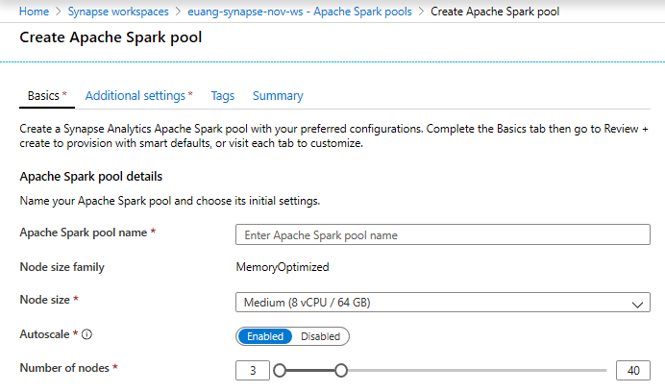
Creating a Spark pool (1 of 2)
Azure Synapse Analytics > Apache Spark > Spark Pool
Provision Spark Pool through Azure Portal with default settings or per requirements
Basic Settings – Minimum details required from user
Only required field from user
Default Settings

Slide 13
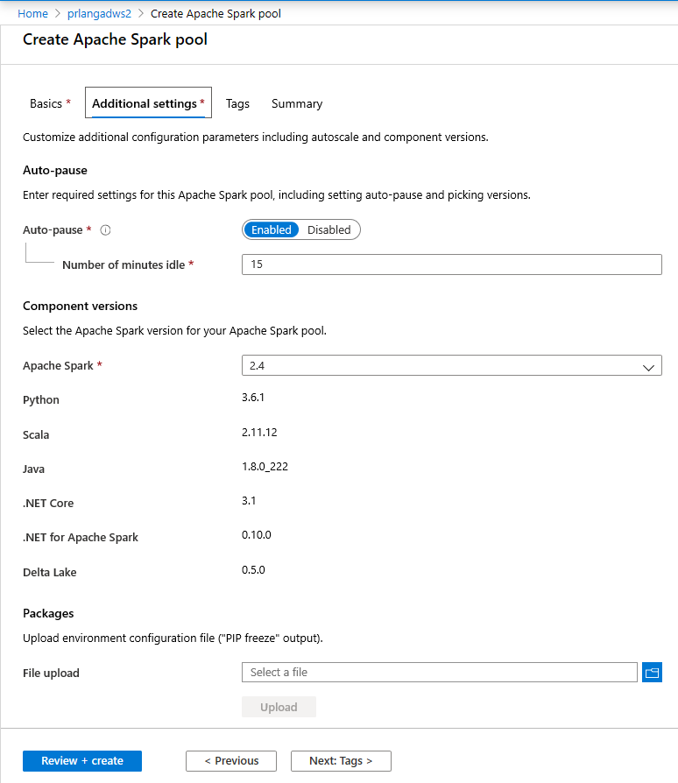
Creating a Spark pool (2 of 2) - optional
Azure Synapse Analytics > Apache Spark > Spark Pool
Additional Settings offer optional settings to customize Spark pool
Customize component versions, auto-pause
Import libraries by providing text file containing library name and version

Slide 14





1
Azure Synapse Analytics > Apache Spark > SQL Connector
JDBC to open connection
Apply any Filters/Projections
Spark reads the data serially
Existing Approach: JDBC
1
Control Node
Compute
Compute
Compute
Compute
Compute
2
3
Driver
Executor
Executor
Executor
Executor
Executor
New Approach: JDBC and Polybase
Control Node
Compute
Compute
Compute
Compute
Compute
Driver
Executor
Executor
Executor
Executor
Executor
1
JDBC to issue CETAS + send filters/projections
3
Spark reads the data in parallel
2
Apply any Filters/Projections
DW exports the data in parallel
User Provisioned Workspace-Default Data Lake

Slide 15
Code-Behind Experience
Azure Synapse Analytics > Apache Spark > Simplified Experience
Existing Approach
New Approach
val jdbcUsername = "<SQL DB ADMIN USER>"
val jdbcPwd = "<SQL DB ADMIN PWD>"
val jdbcHostname = "servername.database.windows.net”
val jdbcPort = 1433
val jdbcDatabase ="<AZURE SQL DB NAME>“
val jdbc_url = s"jdbc:sqlserver://${jdbcHostname}:${jdbcPort};database=${jdbcDatabase};encrypt=true;trustServerCertificate=false;hostNameInCertificate=*.database.windows.net;loginTimeout=60;“
val connectionProperties = new Properties()
connectionProperties.put("user", s"${jdbcUsername}")
connectionProperties.put("password", s"${jdbcPwd}")
val sqlTableDf = spark.read.jdbc(jdbc_url, “dbo.Tbl1", connectionProperties)
// Construct a Spark DataFrame from dedicated SQL pool
var df = spark.read.sqlanalytics("sql1.dbo.Tbl1")
// Write the Spark DataFrame into dedicated SQL pool
df.write.sqlanalytics(“sql1.dbo.Tbl2”)

Slide 16
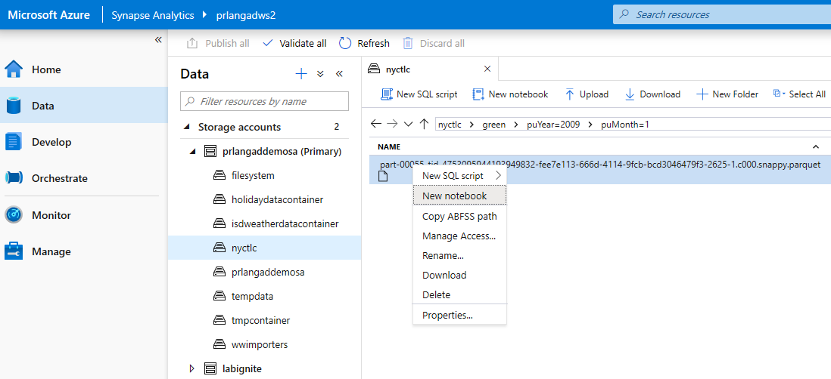
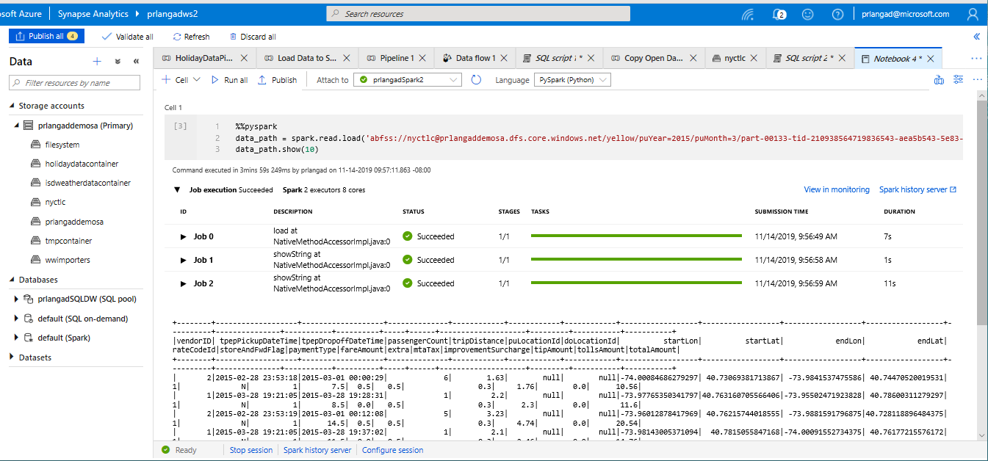
Create Notebook on files in storage
Azure Synapse Analytics > Apache Spark > Simplified Experience

Slide 17
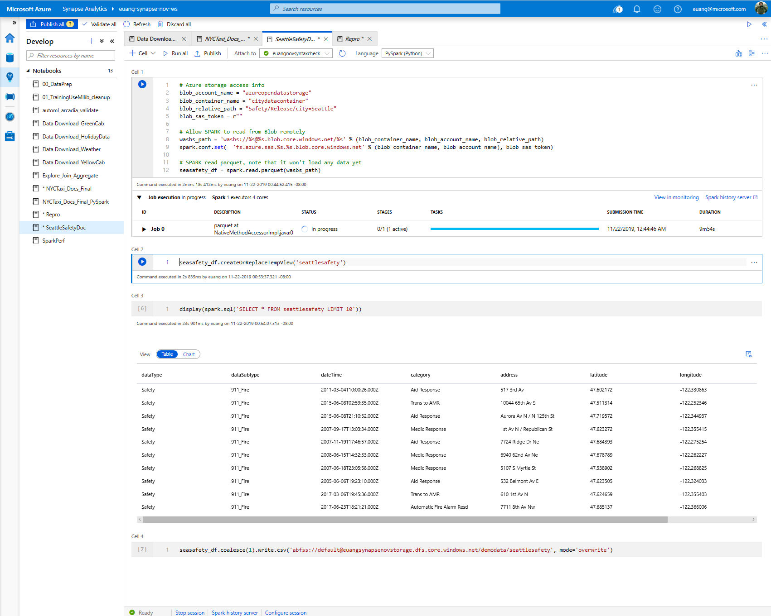
Azure Synapse Analytics > Apache Spark > User Experience and Languages
View results in table format

Slide 18
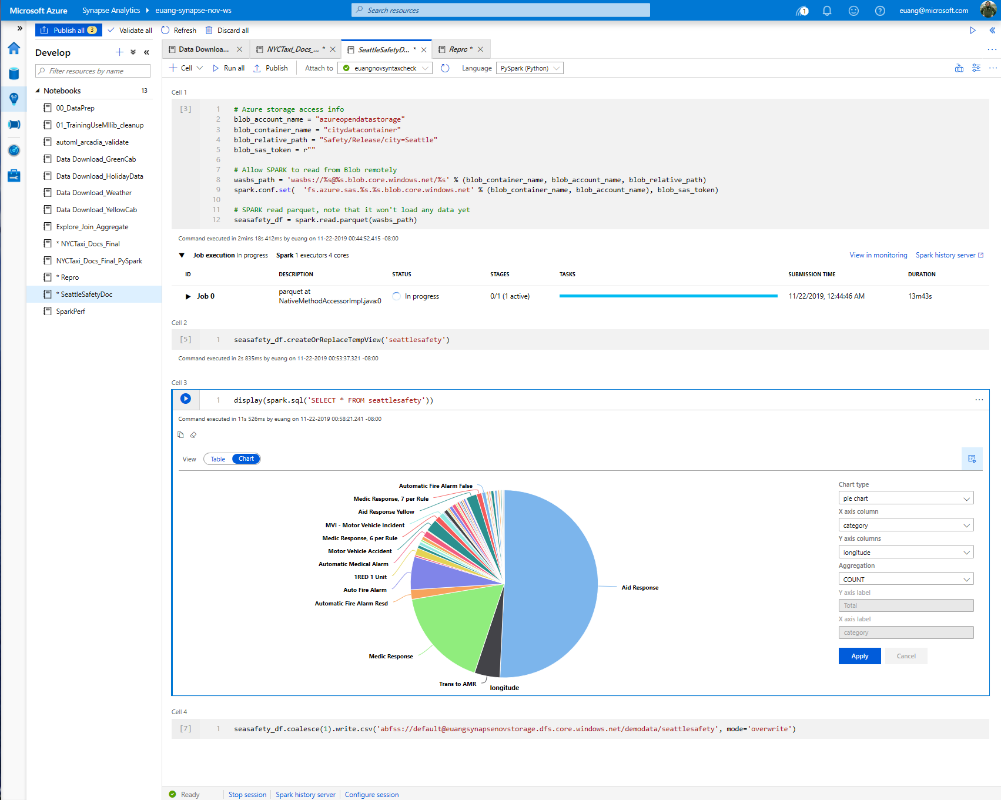
Azure Synapse Analytics > Apache Spark > User Experience and Languages
Azure Synapse Analytics > Spark > Languages
SQL support
View results in chart format

Slide 19
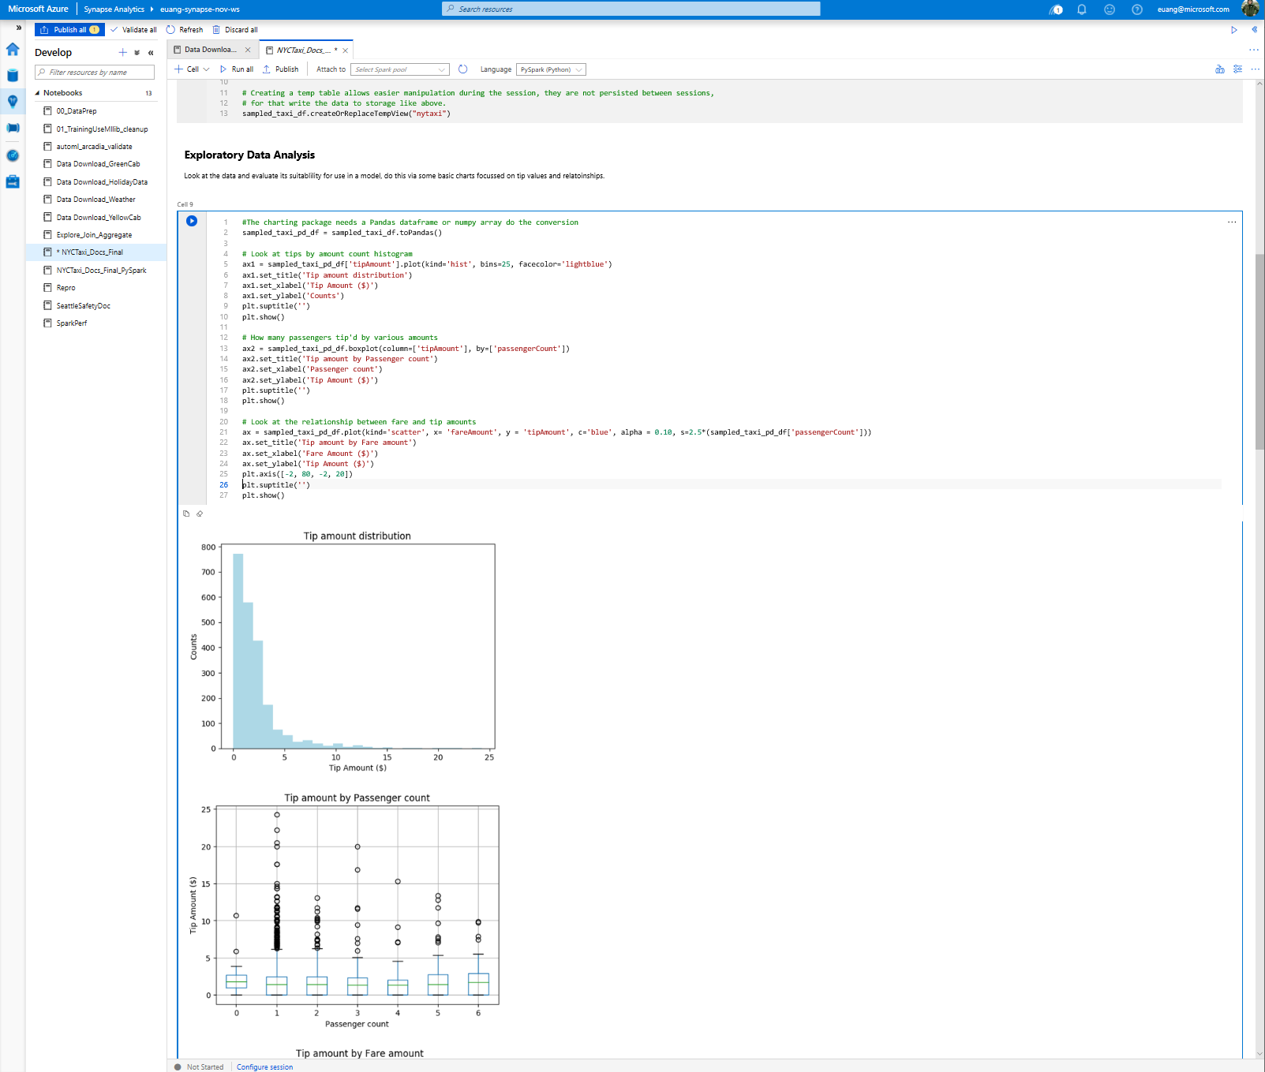
Azure Synapse Analytics > Apache Spark > User Experience and Languages
Exploratory data analysis with graphs – histogram, boxplot etc

Slide 20
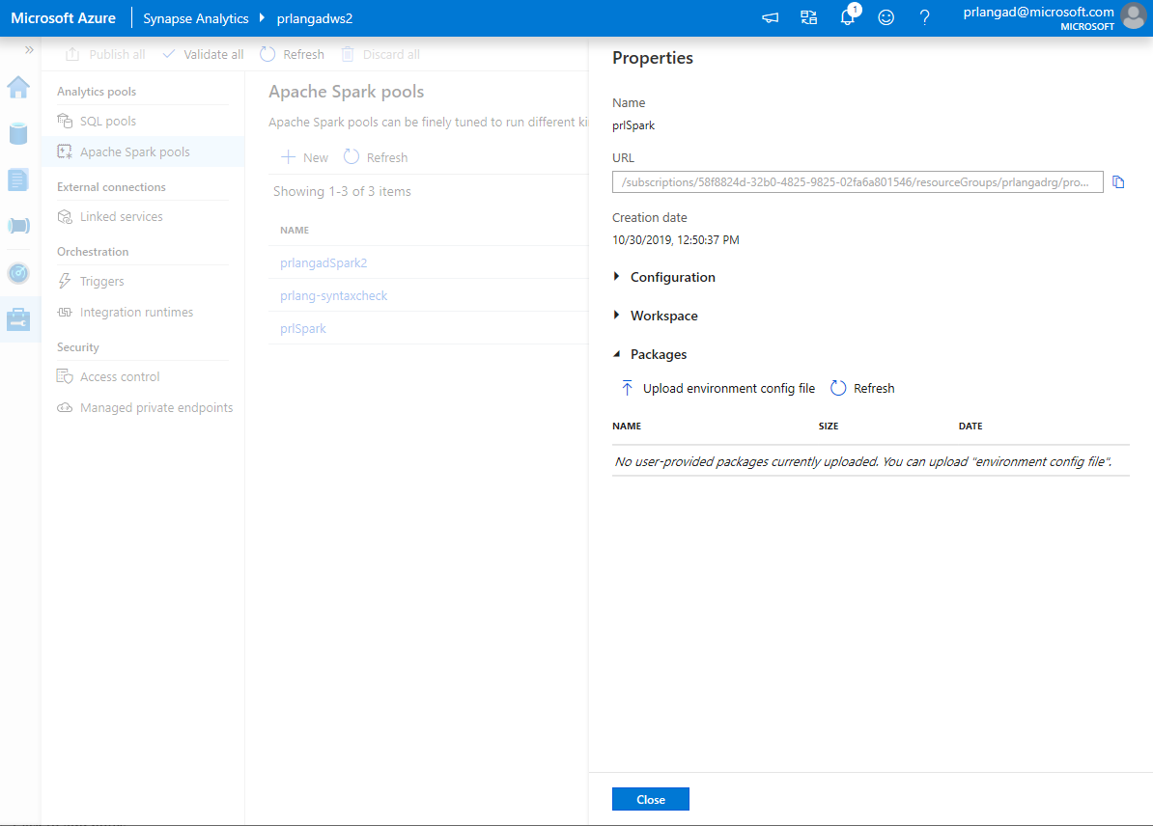
Library Management - Python
Azure Synapse Analytics > Apache Spark > Library Management
Overview
Customers can add new python libraries at Spark pool level
Benefits
Input requirements.txt in simple pip freeze format
Add new libraries to your cluster
Update versions of existing libraries on your cluster
Ability to specify different requirements file for different pools within the same workspace
Constraints
The library version must exist on PyPI repository
Version downgrade of an existing library not allowed

Slide 21
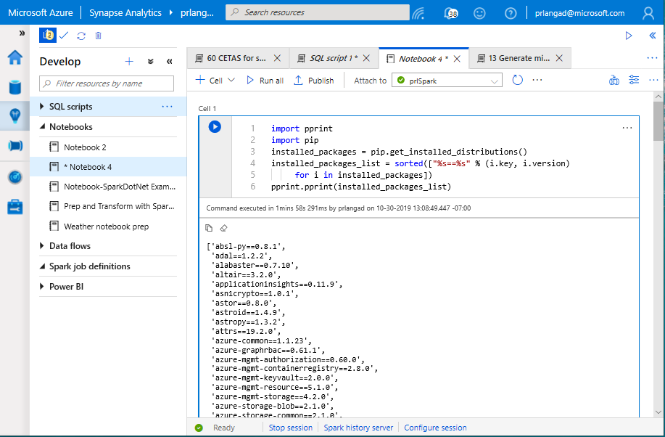
Library Management - Python
Azure Synapse Analytics > Apache Spark > Library Management
Get list of installed libraries with version information

Slide 22
Spark ML Algorithms
Azure Synapse Analytics > Apache Spark > Machine Learning
Classification and Regression | Linear Models (SVMs, logistic regression, linear regression) Naïve Bayes Decision Trees Ensembles of trees (Random Forest, Gradient-Boosted Trees) Isotonic regression
Clustering | k-means and streaming k-means Gaussian mixture Power iteration clustering (PIC) Latent Dirichlet allocation (LDA)
Collaborative Filtering | Alternating least squares (ALS)
Dimensionality Reduction | SVD PCA
Frequent Pattern Mining | FP-growth Association rules
Basic Statistics | Summary statistics Correlations Stratified sampling Hypothesis testing Random data generation
Spark ML Algorithms

Slide 23
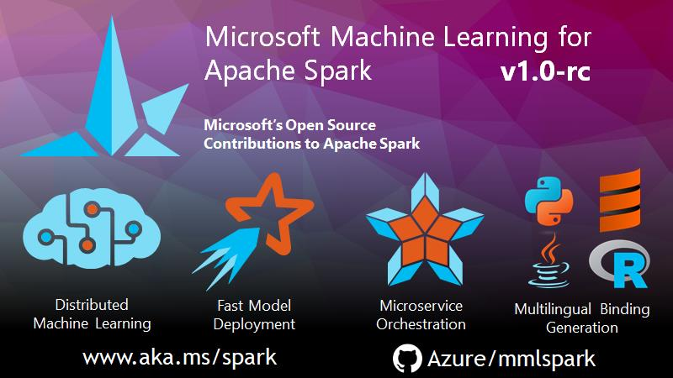

Slide 24
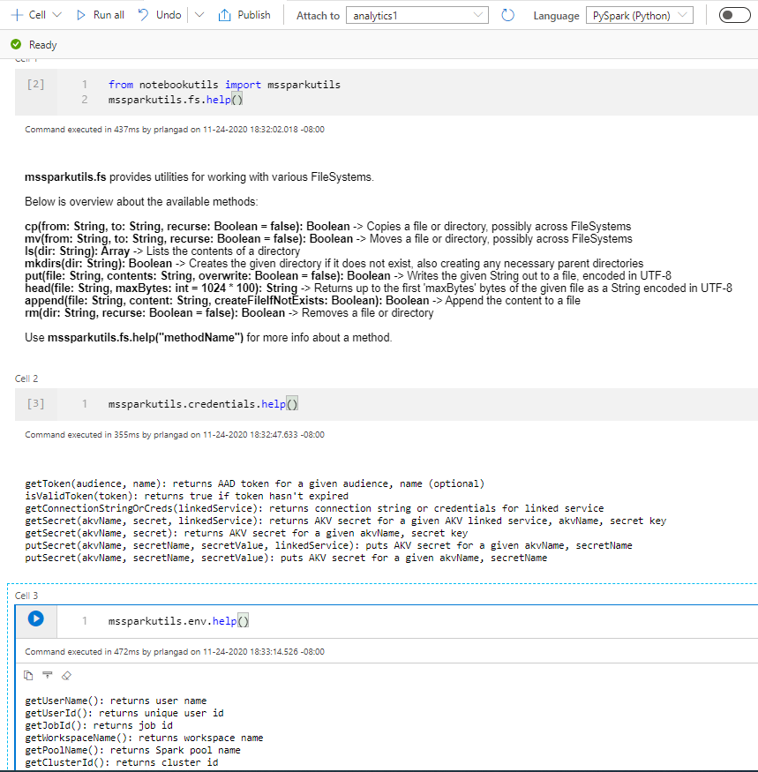
Microsoft Spark Utilities
Azure Synapse Analytics > Apache Spark > Mssparkutils
Overview
It provides utilities for working with file systems, including ADLS Gen2 and Azure Blob Storage.
Benefits
It supports multiple methods for file systems such as List, Copy, Move, Write, Append, Delete file or directory, View file properties, Create new directory, Preview file content.
It supports environment utilities to get username, user id, job id, workspace name, pool name, cluster id.
It supports to get the access tokens of linked services and manage secrets in Azure Key Vault.
Notes:
Microsoft Spark Utilities

Slide 25
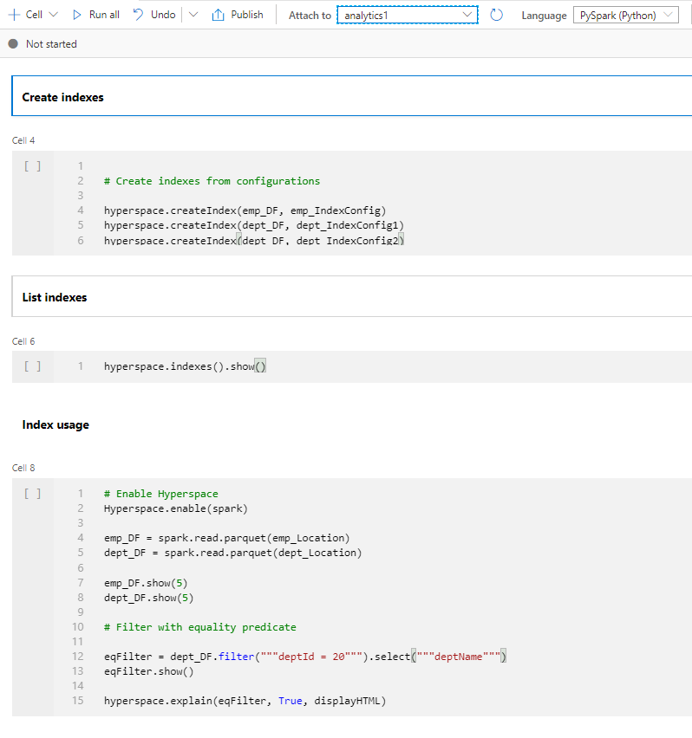
Hyperspace
Azure Synapse Analytics > Apache Spark > Hyperspace
Overview
Hyperspace introduces the ability for Apache Spark users to create indexes on their data
Benefits
It helps accelerate your workloads or queries containing filters on predicates with high selectivity or a join that requires heavy shuffles.
Maintain the indexes through a multi-user concurrency model.
Leverage these indexes automatically, within your Spark workloads, without any changes to your application code for query/workload acceleration.
It supports index operations as create index, list index, restore index, delete index, vacuum index
Languages supported: Scala, Python, .NET
Spark ML Algorithms
Notes:
Hyperspace indexes for Apache Spark - Azure Synapse Analytics | Microsoft Docs

Slide 26
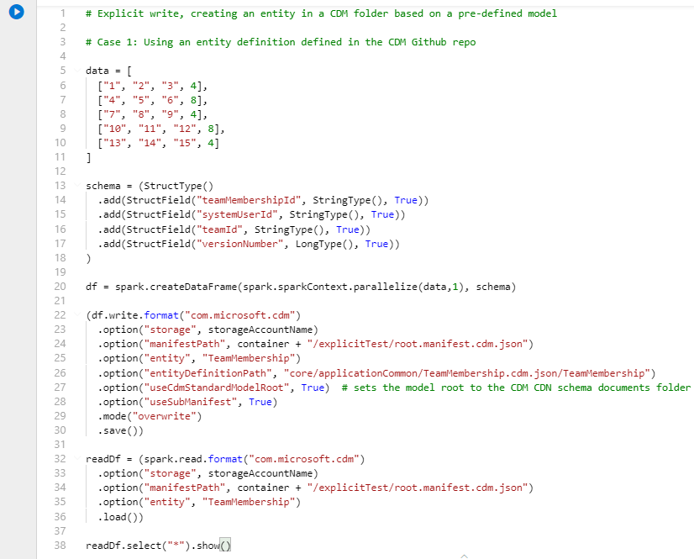
Spark CDM connector
Azure Synapse Analytics > Apache Spark > Spark CDM connector
Overview
It offers Spark dataframes to read and write entities in a CDM folder.
Benefits
It supports use of Managed Identities for Azure resources to mediate access to the Azure datalake storage.
Writes from a Spark dataframe to an entity in a CDM folder based on dataframe schema or CDM entity definition.
Supports data in Apache Parquet format and CSV format.
The CDM connector is pre-installed and supports languages: Python, Scala
Spark ML Algorithms
Notes:
Azure/spark-cdm-connector (github.com)

Slide 27

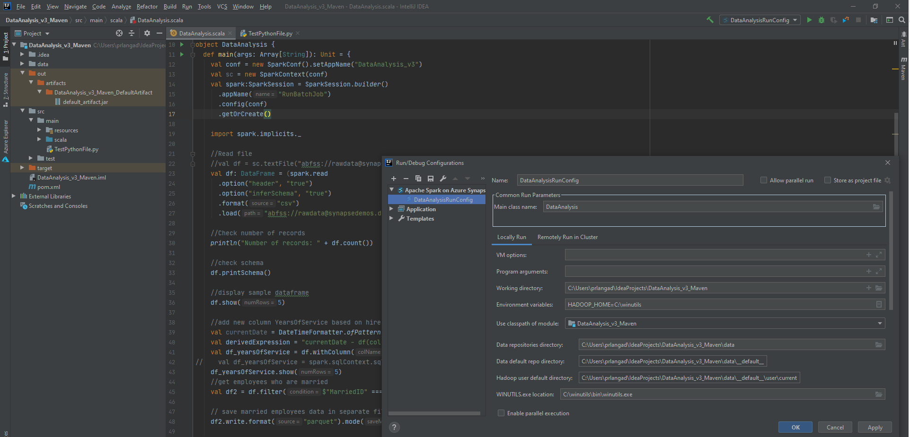
IntelliJ IDE
Azure Synapse Analytics > Apache Spark > IntelliJ IDE
Use the Azure Toolkit for IntelliJ plug-in to develop Apache Spark applications and submit applications to Spark pools.
Spark ML Algorithms
Notes:
Tutorial - Azure Toolkit for IntelliJ (Spark application) - Azure Synapse Analytics | Microsoft Docs

Slide 28
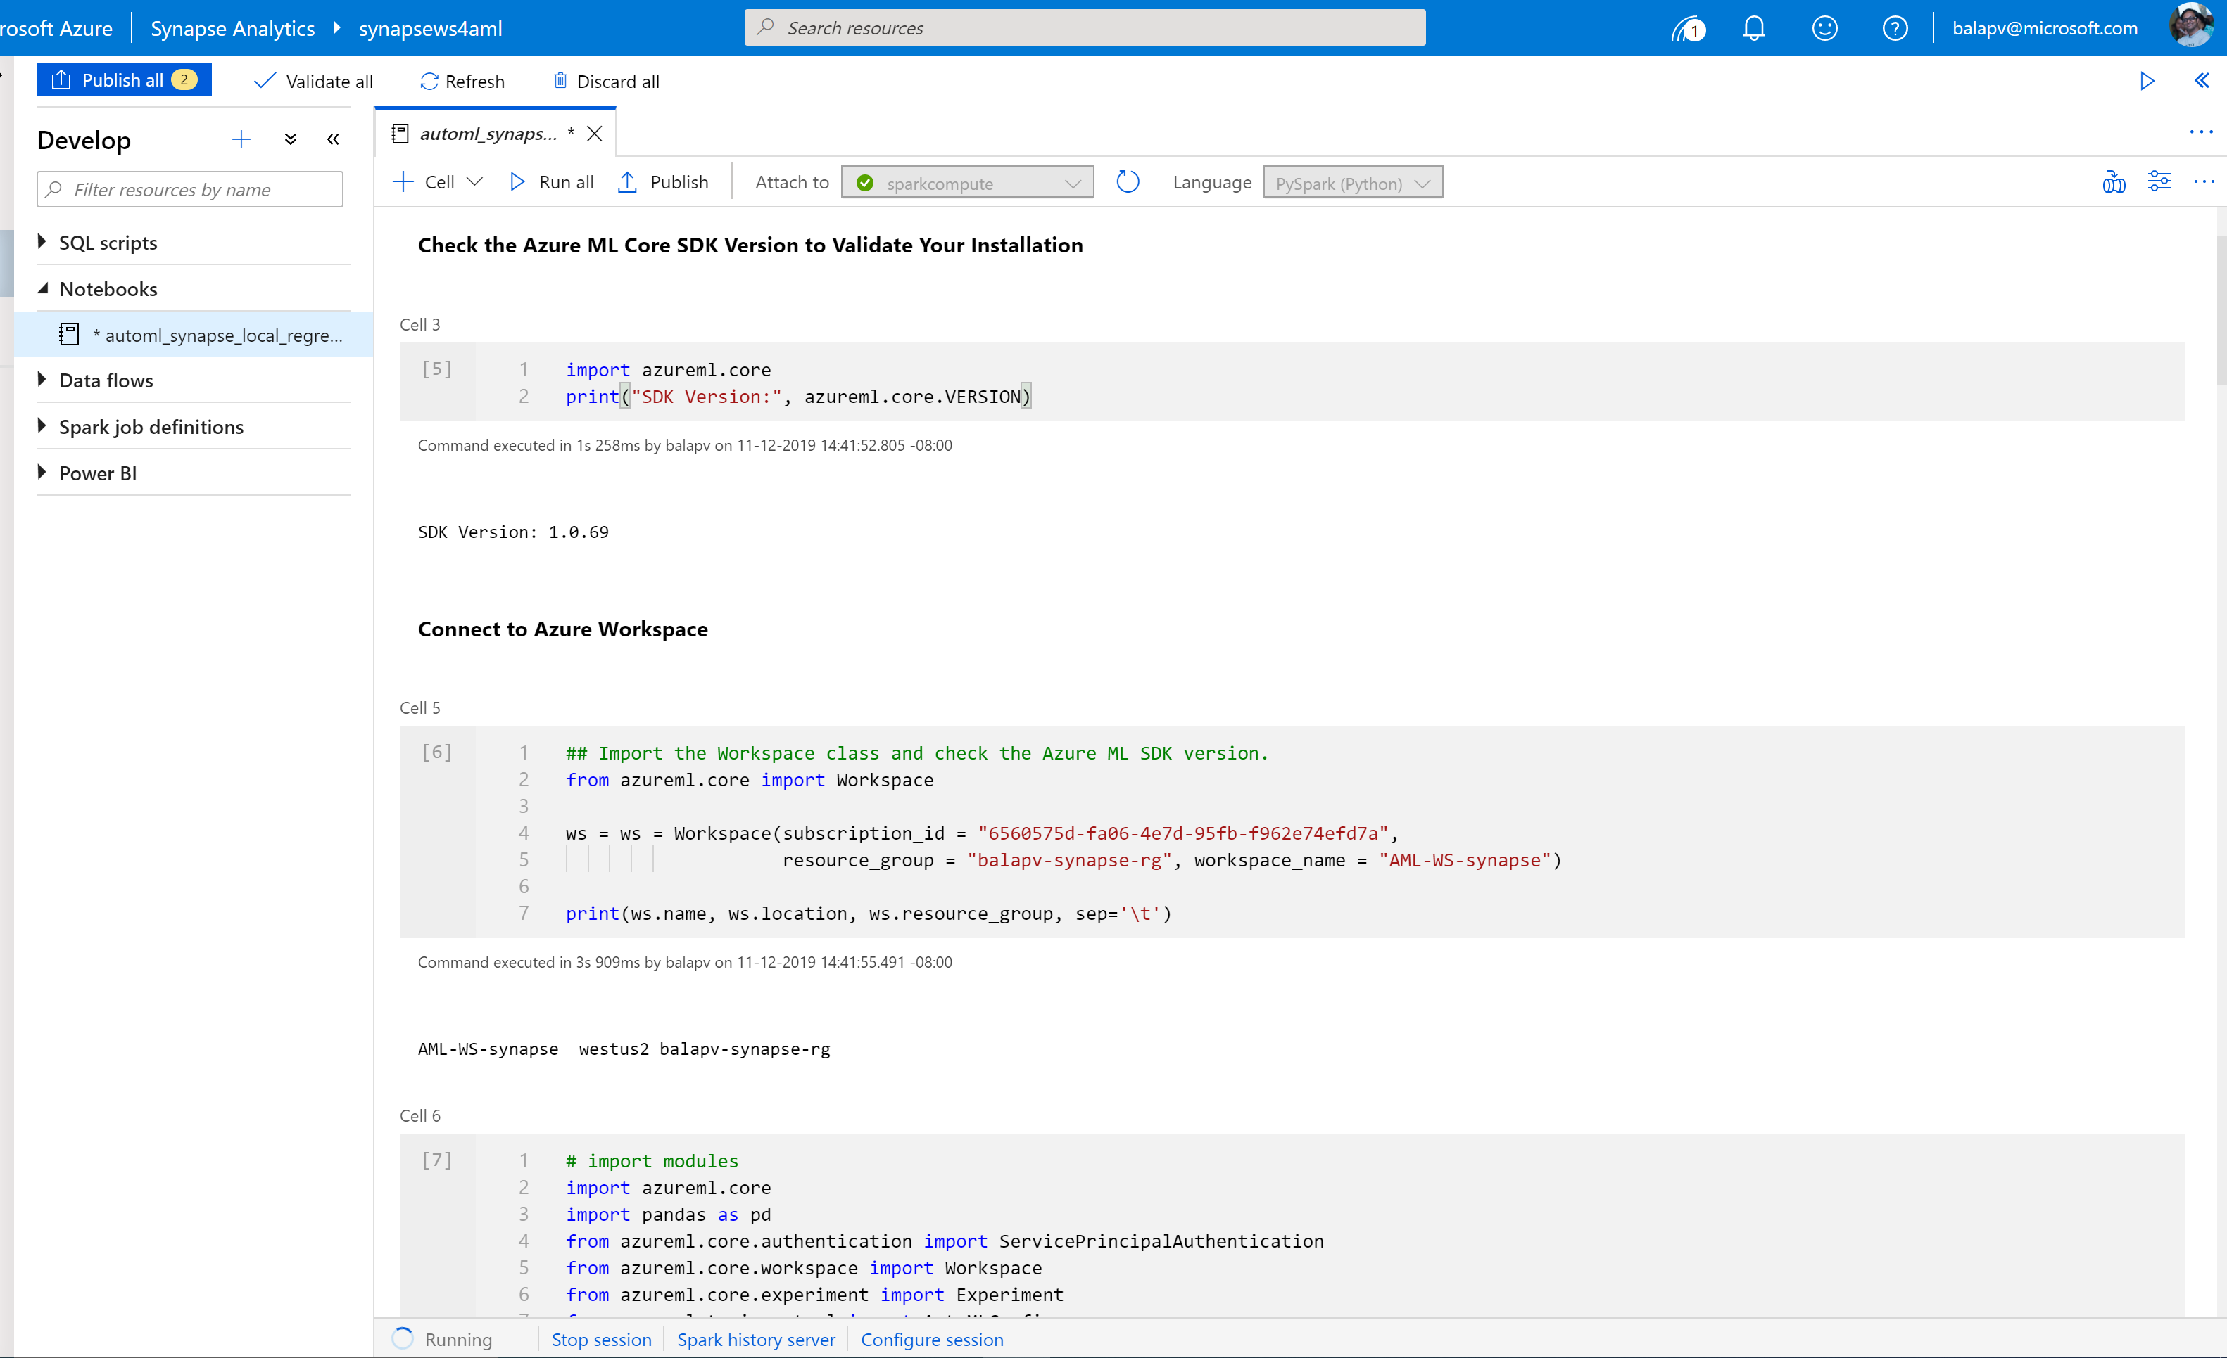
Azure Synapse Analytics > Apache Spark > Machine Learning
Synapse Notebook: Connect to AML workspace
Simple code to connect workspace

Slide 29
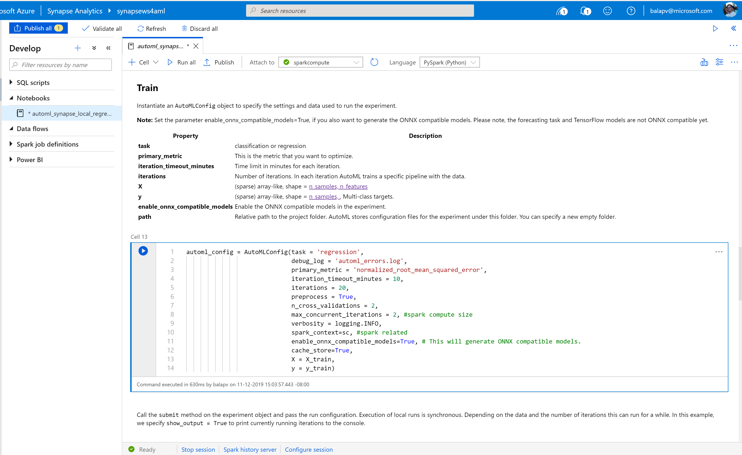
Azure Synapse Analytics > Apache Spark > Machine Learning
Synapse Notebook: Configure AML job to run on Synapse
Configuration parameters

Slide 30
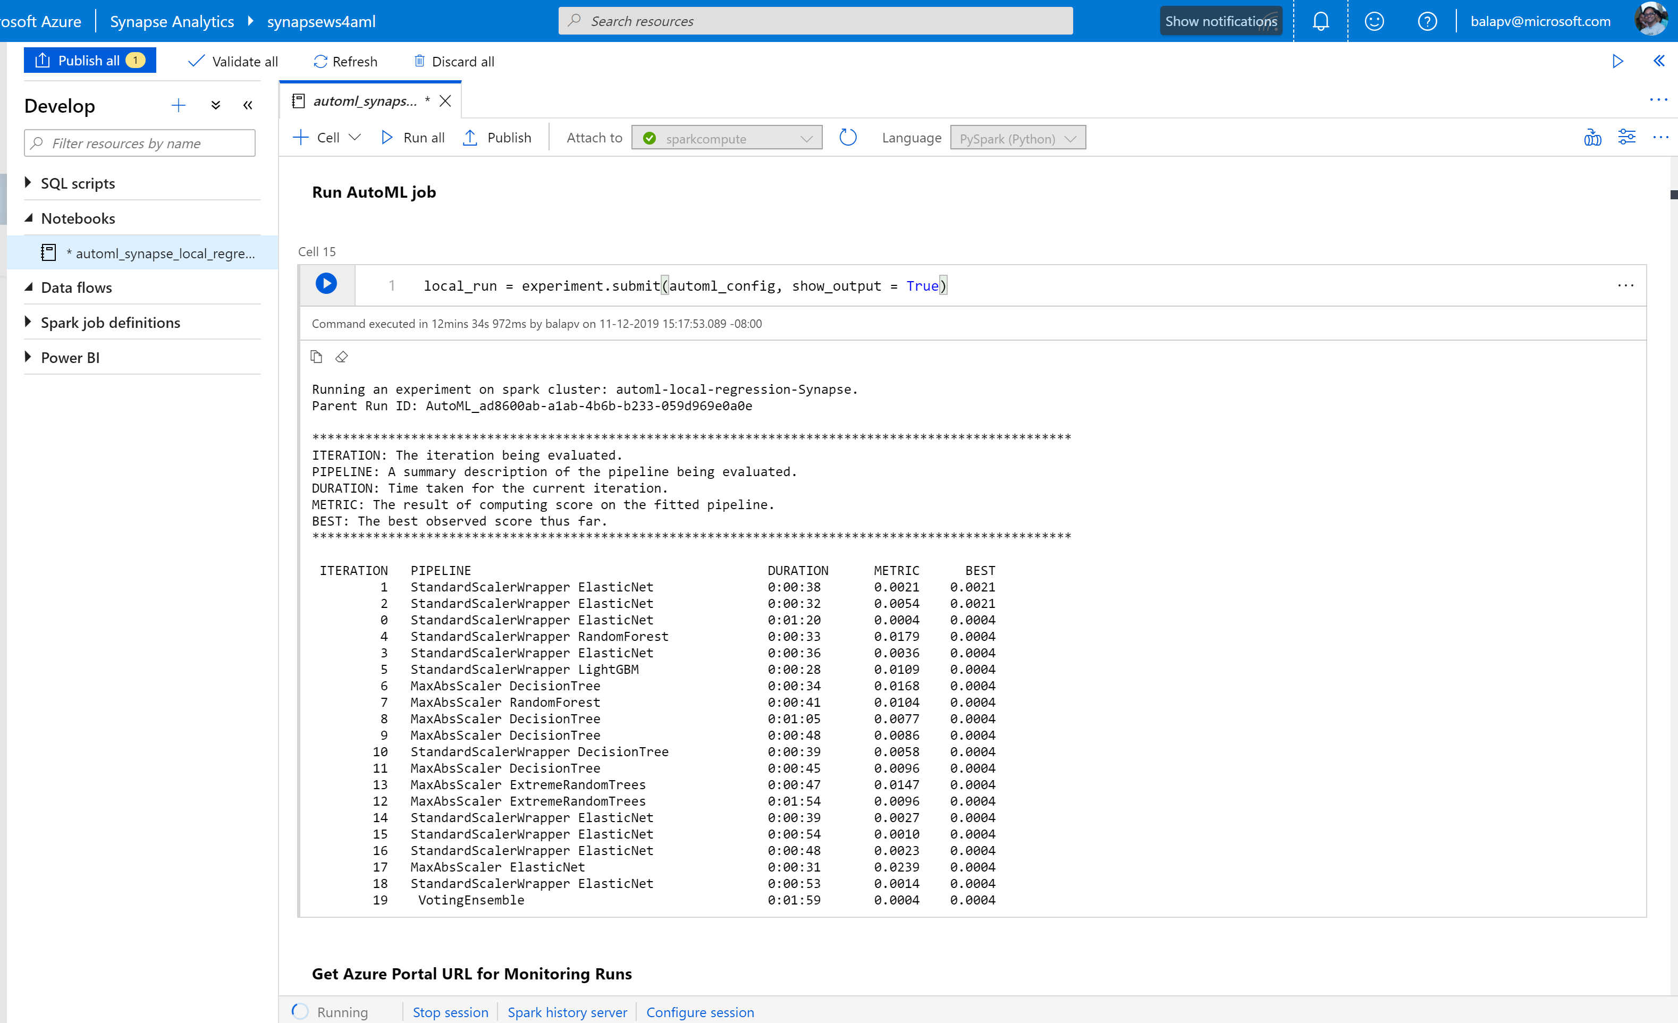
Azure Synapse Analytics > Apache Spark > Machine Learning
Synapse Notebook: Run AML job
ML job execution result

